Slide 1
AWS DeepRacer
Notes:
[Do not read comments in brackets out loud. They are there to help guide you, mostly on time. This applies to all slides]
[0.5 minutes]
Name
Job
Team
Thank you for Joining

Slide 2
Agenda
AWS DeepRacer origin
RL for the Sunday driver
Virtual Simulator
Under the hood
SageMaker RL notebook
Rubber meets the road
Notes:
[0.5 minutes]
What’s in store for us today?

Slide 3
AWS DeepRacer
Notes:
Before we get started, let’s do a quick recap on AWS DeepRacer.

Slide 4
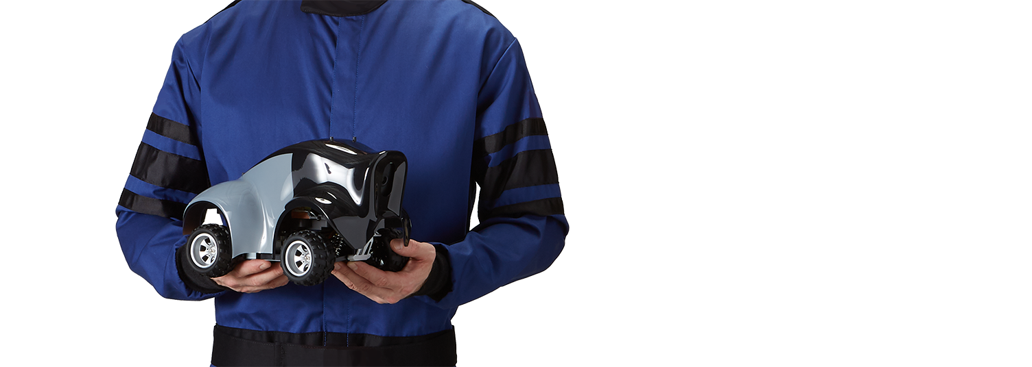
AWS DeepRacer origin
How can we put Reinforcement Learning in the hands of all developers? literally
Notes:
[1 minute]
Developers told us they love the hands-on learning approach used in DeepLens
In 2018 Amazon SageMaker added support for Reinforcement Learning
We asked the question “How can we put Reinforcement Learning in the hands of all developers (literally)?”
And so the idea of AWS DeepRacer was born

Slide 5
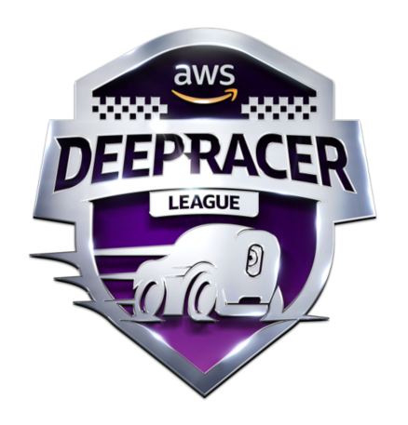
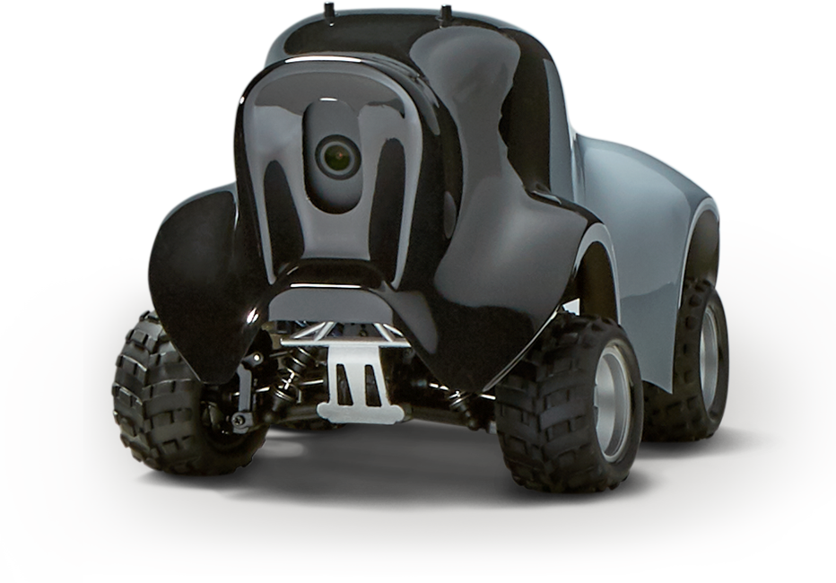
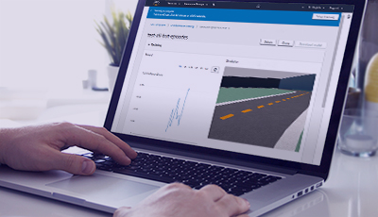
AWS DeepRacer: An exciting way for developers to get hands-on experience with reinforcement learning
Robotic autonomous
race car
Virtual simulator, to train and experiment
Racing League
Notes:
[2 minutes]
[Before you tell customers they can order/pre-order the car, check if available in your region!!! Otherwise don’t call it out]
At re:Invent 2018 we launched AWS DeepRacer.
AWS DeepRacer is a 1/18th scale robotic car which gives you an exciting and fun way to get started with reinforcement learning (RL) by applying it to autonomous racing.
You can order/pre-order your AWS DeepRacer from Amazon today.
AWS DeepRacer has a virtual racing simulator that allows you to train, evaluate, and iterate on your RL models in a racing environment, quickly and easily.
And if you get really good, and want to showcase your machine learning skills in a competitive environment, there is the AWS DeepRacer league. You can compete in a global championship - racing your DeepRacer model- for a chance to win several prizes and advance to the AWS DeepRacer Championship Cup. Throughout 2019 there will be in person events at selected Aws Summits and a series of virtual competitions hosted in the virtual simulator, giving all developers the ability to compete.

Slide 6
RL for the Sunday driver

Slide 7
Machine Learning overview
SUPERVISED
Example Driven Training – every datum has a corresponding label
UNSUPERVISED
No labels for training data
REINFORCEMENT
Learns through consequences of actions in a specific environment
Notes:
[1 minute]
Machine Learning has three main categories.
Supervised learning. Build a model to predict a value or a classify data. Models are trained using large amounts of curated training data, consisting of label and data pairs, to learn. Models learn to accomplish a well defined single task, and don’t scale easily to other tasks or sub-tasks without new data. Example is linear regression.
Unsupervised learning. Build a model to classify data. Models are trained to identify similarities in large amounts of data to aid classification. Training data does not have explicit labels. An example is clustering.
Reinforcement learning. Build a model to make autonomous decisions in an environment. Models are trained in an environment, by learning from interaction with the environment which decisions/actions led to good outcomes, and which led to bad outcomes. You need to supply the environment and very importantly the reward function to help it determine if an action was good or bad. Example is policy optimization.

Slide 8
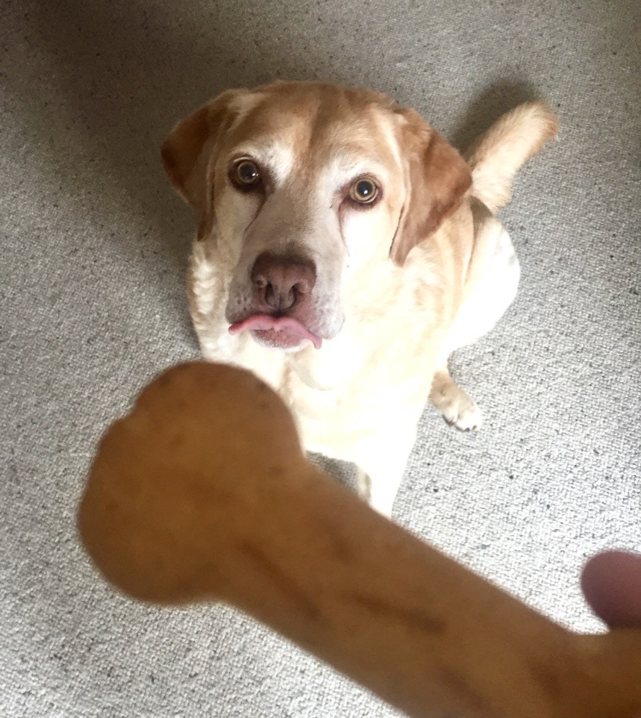
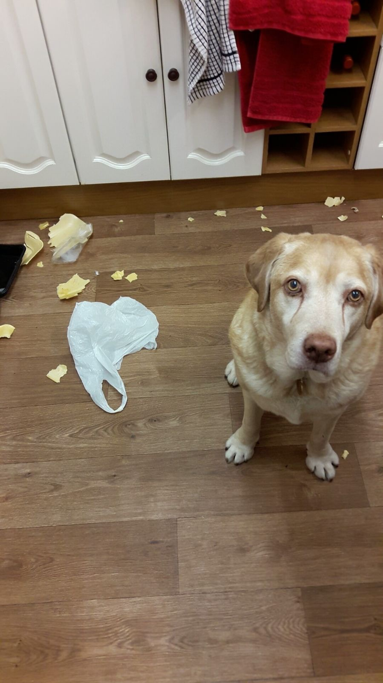
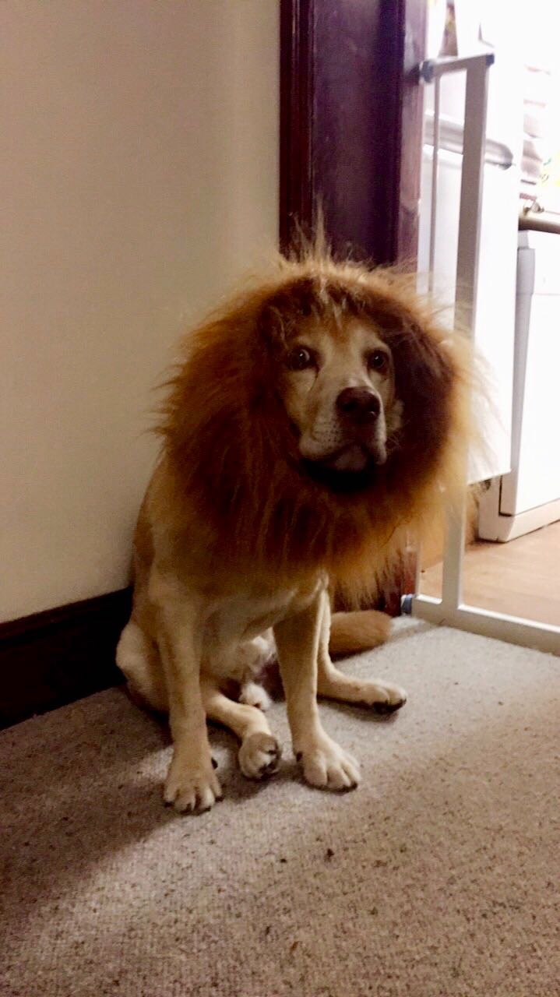
Reinforcement Learning in the real world
Reward positive behavior
Don’t reward negative behavior
The result!
Notes:
[1 minute]
Reinforcement learning is built on and idea that is used quite often, perhaps daily, by humans. When was the last time you used a reward to incentivize the right behavior…
Think about the method used to train a pet – treats are used to incentivize desired behavior.
Training can be for simple actions like sit or stay, to more complicated series of behaviors, like you sometimes see in dog agility courses – crawling through tunnels, jumping over hurdles, and weaving through poles.

Slide 9

Sparse reward function in a race grid
S |  |  |  |  |  |  | G = 2
AGENT
GOAL
Notes:
[2 minutes]
Like using rewards with pets, we will use a reward function to incentivize the desired driving behavior in our agent.
What is a reward function? Simply a function helps your agent determine if the action it just took was good or bad and how good or bad.
Let’s look at this race grid to see a practical example of a reward function. The blue square is our agent’s starting position, green represents its goal. It can move to every other square, except purple, one square at a time. Each square is called a state, and our agent can choose from the following actions in each state: move forward, left, or right, always facing in the direction of the goal and only visit each state once.
This is an example of a “sparse reward function”, it simply says that when the agent reaches the goal it will get a reward of 2.
This is like trying to teach your dog to sit, then lie down, then bark, and then shake and only then will you reward them. It will probably take a long time to learn this behavior, if at all.
Our agent will also take a long time to learn the right behavior as there are many paths to get to the goal, and it won’t know which one is better.
How can we improve this?

Slide 10
Reward function that incentivizes centerline behavior
0.1 | 0.1 | 0.1 | 0.1 | 0.1 | 0.1 | 0.1 | 0.1
S | 2 | 2 | 2 | 2 | 2 | 2 | G = 2
0.1 | 0.1 | 0.1 | 0.1 | 0.1 | 0.1 | 0.1 | 0.1
8.6 | 9.5 | 8.5 | 7.5 | 6.3 | 5.0 | 3.5 | 1.9
S | 10.4 | 9.4 | 8.2 | 6.9 | 5.4 | 3.8 | G = 2
8.6 | 9.5 | 8.5 | 7.5 | 6.3 | 5.0 | 3.5 | 1.9
MAX VALUE OF EACH STATE AFTER LOTS OF EXPLORING
REWARD FUNCTION
Discount per step 0.9
Notes:
[4 minutes]
We introduce a reward function that provides a reward for each state. In our example we want to incentivize the agent to follow the centerline, because we think that will work best, and so we give higher rewards for actions that result in the agent ending up in the centerline.
Why will providing a higher reward in the center incentivize center line driving behavior?... [pause]
RL algorithms seek to train models that will choose that set of actions (a path so to speak) that maximizes the cumulative expected rewards from any state. Simply put from any state choose the action that will give the highest sum of future rewards. We call this the value function.
We also introduce the concept of a discount, to penalize the car for each step taken. Discounting limits how far into the future we look.
To build up this value function our agent will explore all state and actions and build a table reflecting the value of being in each state, shown on the right. This value is the maximum cumulative reward achievable from each state when it selects the actions in subsequent states leading to states with highest value. Learning doesn’t just happen in the first go, it takes some iteration, because it first needs to explore and see where it can get the highest rewards, before it can exploit that knowledge.

Slide 11
AWS DeepRacer problem formulation
MODEL
AGENT
ACTION
STATE
ENVIRONMENT
GOAL
Notes:
[2 minute]
We are interested in the creation of a model that can be used by AWS DeepRacer, our agent, to choose which actions to take from any state in our race track environment in order to reach our goal of completing the track. When we have our trained model the only input into the model is the state, the image from the camera, and the output is the action, the speed and direction to our engine and steering.
The reward function is only used during training to help optimize the RL model to choose the actions that lead to the maximum cumulative reward. Once the model is trained there is no way to give feedback on how good or bad an action was, not in the simulator and not in the real world.

Slide 12
How does learning happen?
VALUE FUNCTION
STATE
REWARD
POLICY FUNCTION
AGENT
ENVIRONMENT
ACTION
Notes:
[5 minutes]
As in our grid race we saw we have to first explore the environment to know which actions from which states are the best actions.
In the simulator AWS DeepRacer will drive around the track and take 15 pictures per second. Each time it takes a picture we refer to as a step. Each picture represents the state it is in, and using an RL model it will inference which action to take. This will lead to a new state (the outcome of the action) and using the reward function it will then calculate the reward based on the outcome. The process will continue in each state, until we get to a terminal state where the car goes off track or finishes the lap. The car will then reset and repeat the process. Each step is a (state, action, new state, reward) tuple and all steps from the reset point till the terminal state is called an episode. You should think of these episodes as experience, or training data for our model.
The initial model used to determine which action to take doesn’t know anything. And so our RL algorithm will initially select actions at random. This is so we can explore the environment. After a set number of episodes, we will train our model and improve it using the experience we built up. The improved model will then be used to collect more experience, after which we will train again and get an even better model.
We determine how long we will select random actions over the actions determine by our model. If we start exploiting our new found experience too soon, we may end up missing a better path. Similarly if we keep on randomly choosing actions to explore more, we may end up taking a very long time to train a model.
If you can explore all state, action combinations you will end up with a value function, like in our grid race. We can then introduce a policy function. A policy function is a mapping from a state to an action. A simple policy once we know the value function is to say always choose the action that will end up in the state with the highest value.
So this is easy when you can explore every possible state/action combination – just build a lookup table like in our grid race track example.
BUT for many environments, like in AWS DeepRacer, you can’t explore every state/action combination and so you can’t fully determine the value function or a policy function.
Two methods we use are Value Approximation and Policy Optimization.

Slide 13

RL algorithms – Vanilla Policy Gradient
Goal: Maximum of cumulative rewards
0.4 ± 𝛿
0.3 ± 𝛿
New
weights
J(θ)
New
weights
Output
Input
Layer
Hidden
Layers
Gather episode using current policy
Calculate the gradient of Est. Cumulative Reward
Update the policy for gradient ascent
Data is only used once
High variance of rewards
Magnitude of update could be too large
* Image Source: Landscape image is CC0 1.0 public domain
Notes:
[4 minutes]
Let’s look at an example of policy optimization – vanilla policy gradient
This is a method where we parameterized our policy function, the parameters are simply the weights in a neural network, and the neural network represents our policy function. All this policy function does is take an image as input and outputs an action. Thus mapping state to action.
We then optimize that policy to get the best action from each state. Our goal is to get the maximum cumulative reward. We train our model we update the weights by trying to maximize the cumulative future reward, and in doing so we give higher probability to the action that leads to the higher cumulative future reward.
DeepRacer uses a form of Policy Optimization, called Proximal Policy Optimization.

Slide 14

RL algorithms – Proximal Policy Optimization
Gathering training data
PPO gradient update
Actor (Policy)
Critic (Value)
Updating the policy with new policy
(s_{t},a_{t}, r_{t}, s_{t+1})
( State, Action, Reward, Next State )
mini-batch
advantage
Experience Replay Buffer
Repeat episodes,
Run policy in an environment
Store episode data into buffer
Training policy for K epochs with minibatch
Compute PPO gradient
Update policy
Notes:
[4 minutes]
On this slide we provide a high level overview of the whole training process when using PPO
On the left we have our simulator using the latest policy (model) to get new experience.
The experience is fed into an experience replay buffer which feeds our Proximal Policy Optimization algorithm
While PPO is a policy optimization method that uses an actor critic method to learn.
Actor Updates Policy using Clipped updates
We clip updates top prevent the policy from being updated too much, a common issue with policy optimization methods.
Typically we keep the ratio of new and old policy in [0.8, 1.2]
Critic tells actor
How good the action taken was, and
How the actor should adjust its network
Once the policy is updated the new policy is sent to get more experience.

Slide 15
RL vs. other approaches for robotic racing
REINFORCEMENT LEARNING
BEHAVIORAL CLONING
METHOD Reinforcement Learning
HOW IT WORKS Virtual Agent repeatedly interacts with a simulated environment and logs experience (image, action, new state, reward). Experience is used to train a model, and new model is used to get more experience.
RESULT Provide state(image) into model and receive driving action
METHOD Supervised learning
HOW IT WORKS Expert driver controls a real world car, that has a camera. Save the images from the camera as inputs and corresponding driving actions (speed and steering angle) as outputs. Train a model.
RESULT Provide state(image) into model and receive driving action
Notes:
[2 minutes]
RL – agent gets training data by itself in simulated environment – RL algorithm
Behavioral Cloning – expert driver controls car and logs images from car and steering input. – Supervised learning
We will take about how to bridge the simulation to real domain transfer challenge later

Slide 16
Virtual Simulator
Notes:
[0.5 minutes … the previous section should have taken 29 minutes. You have 91 minutes left or 1hr and 31 minutes]
For the remainder of this talk we will be focusing on the virtual simulator and what you should expect when building your reinforcement learning models.

Slide 17



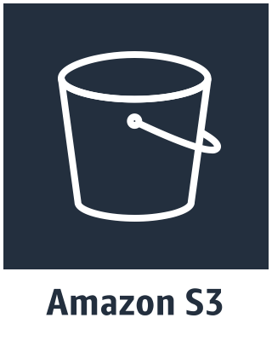





DeepRacer simulator architecture
AWS Cloud
AWS DeepRacer
VPC
Models
Simulation video
AWS DeepRacer
NAT gateway
Metrics
Notes:
[3 min]
Just a quick warm up lap before the race starts.
AWS DeepRacer uses Amazon SageMaker to train the RL models, AWS RoboMaker to provide the simulation environment, Amazon S3 to store models, Amazon CloudWatch to store logs, and Amazon Kinesis Video Stream to display the video in the console. The service is built on top of other AWS services.
When you start training a model in AWS DeepRacer the following happens.
AWS DeepRacer starts an Amazon SageMaker container, and an AWS RoboMaker container in your service account and links the two.
It then passes the right parameters to start the training. The experience (state, action, new state, reward) tuples are generated in AWS RoboMaker and after a specified amount of experience is obtained it is sent back to Amazon SageMaker to train the model. The new model is then sent back to AWS RoboMaker to get more experience, and so the process continues.
The outputs (models, video, and metrics) are stored in other AWS services in your account.
By logging into each of these services you will see the data created from your DeepRacer training jobs.

Slide 18
DeepRacer console diagram
1. Reward function 2. Hyper parameters 3. Action Space
3 Train
2 Configure training
4 Evaluate
1 Create model
5 Tweak model
1. AWS DeepRacer League Virtual/Summit Circuit 2. Test AWS DeepRacer car
Notes:
[2 minutes]
In the AWS DeepRacer console
1. Create a model…
2. Configure training…
From our reinforcement learning overview we saw that the reward function is a pretty important item when it comes to reinforcement learning. And so we will pay close attention to the reward function.
Our reinforcement learning algorithm has certain hyperparameters (such as after how many episodes of experience we update the model) that we need to specify, and we also need to provide the actions from which it should choose.
3. Train the model
4. Evaluate the model, how good is your model? If you are happy go race in the League (virtual or in person) or deploy to the car
5. Tweak mode

Slide 19
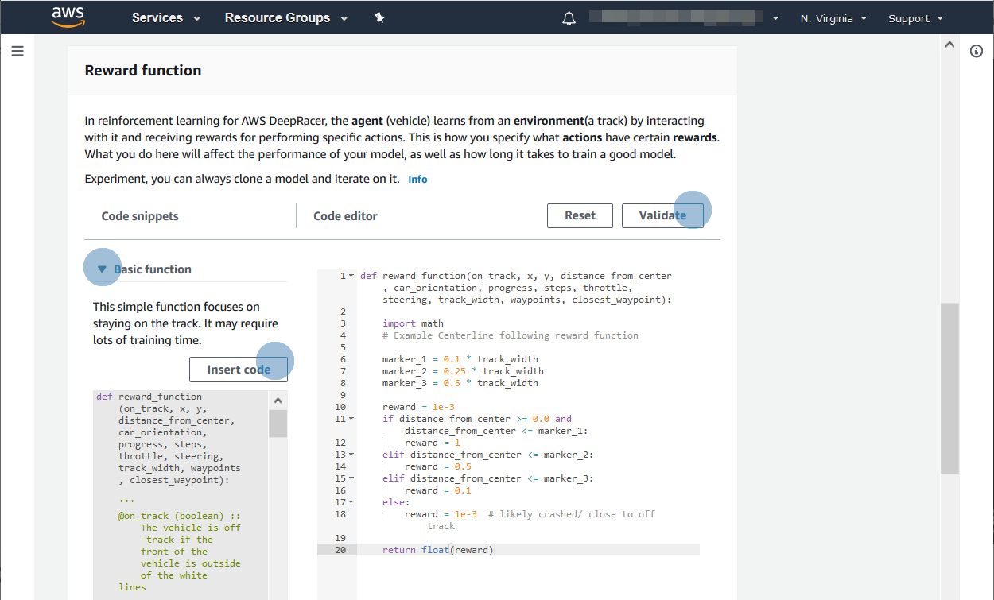
Programming your own reward function
Notes:
[2 minutes] Lets look at the reward function again. During training we take an action in each step and update the position of the car. The reward function will be used to determine how good or bad the outcome of the action is. How would the reward function know if the outcome is good or bad? [pause]
You supply the logic for it to determine how good or bad, and quantify it. And you get variables containing measurements from the simulator after each action that you can use to build reward function logic. You do this in python 3 syntax.
For example, the simulator tells you how close your car is from the center of the track and how wide the track is so you can give a higher reward for being closer to the center of the track.
Let’s look at track components and simulator measurements that can be used for our reward function

Slide 20
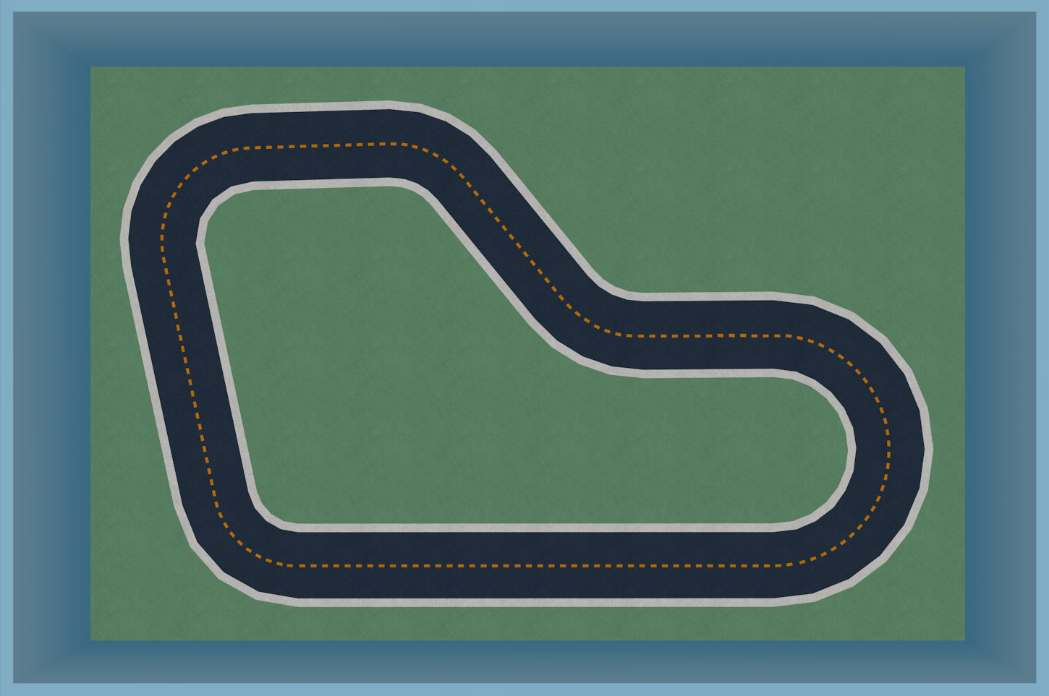

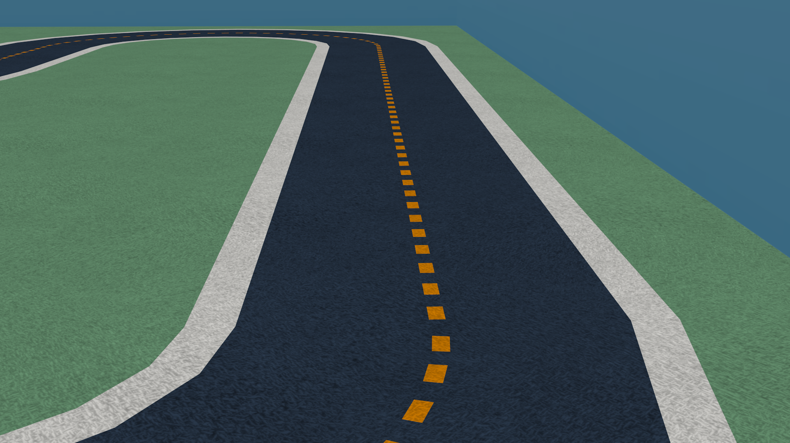
Track components
TRACK WALL
FIELD aka OFF-TRACK
TRACK SURFACE aka ON-TRACK
TRACK BOUNDARIES
TRACK CENTER
Notes:
[2 minutes] This is the first person view of AWS DeepRacer, as it drives down the track. The main components of the track are
The track wall
The field, which is also considered off-track
The track boundaries are the two lines around the track surface
The track surface, or on-track (this includes the two boundary lines)
And the center of the track
These components are important because we can use them to help determine whether an action resulted in a good or bad outcome. There are a few other components we should also look at

Slide 21
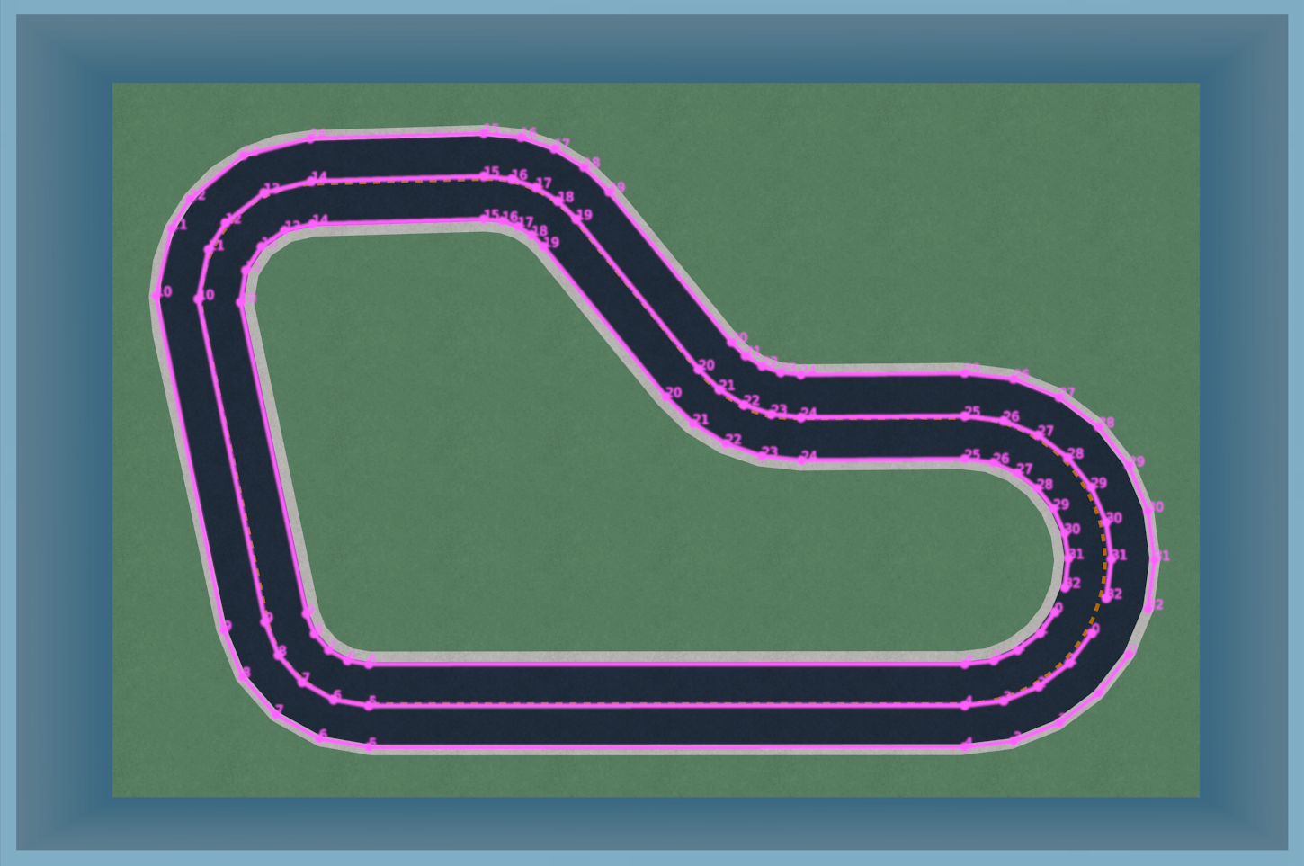
Coordinate system and track waypoints
CAR YAW
Y
TRACK WIDTH
OUTER BOUNDARY WAYPOINTS
TRACK CENTER WAYPOINTS
INNER BOUNDARY WAYPOINTS
X
Notes:
[3 minutes]
And that is the coordinate system and track waypoints.
This is a 3D environment so it has an X, Y, and Z axis. For simplicity we are only showing the X, and Y axis.
Your car has an (X,Y) position associated with it.
We provide “waypoints” spread around the track in the center of the track as a series of (X,Y) points (the superimposed pink line in center of the track).
The waypoints help us to programmatically determine a how much of the track DeepRacer has completed, where the center line of the track is, in (x,y) coordinates, the distance that DeepRacer is from the center of the track, and the direction of the flow of the track…
We can go one step further and determine the direction, with respect to the x-axis, from one waypoint to the next. We leave this to you
We also have waypoints for the outer boundary, and inner boundary.
All of these track components and track waypoints are important because after every action in the state – action – reward – new state loop, they are variables that we can use to build logic to determine whether an outcome was good or bad.
Also important to call out here, and reinforce it, mind the pun, is that this feedback loop only exists in the virtual world, and as such training can only happen in the virtual world. There is no feedback loop on the physical car to help it determine if an action was good or bad.

Slide 22
Hyper parameters control the training algorithm
Learning rate
Larger LR train faster, but may struggle to converge
Batch size
Larger batch promotes stable updates, slower training
Epochs
Larger epochs promotes stable updates, slower training
Discount factor
Larger df means model looks farther out, slower training
# of Episodes
Larger # improves model stability, slower training
Notes:
[4 mins]
WHAT are hyper parameters?
These are parameters that feed into the reinforcement learning algorithm.
They control various aspects of the algorithm, such as how quickly it should learn, how often we should train the network.
What is the network again, the network is the “model” that when we give it an image or state as input, will return the action that should maximize the cumulative rewards from all future states. Weights are the “coefficients” in our neural network that help determine where we “look” in each picture to select the action that will maximize our expected cumulative rewards.
Some PPO Parameters are
Learning rate Controls how big the updates are to your network weights. If your learning rate is big the model will train fast but may not converge
Batch When we update the network we don’t typically use all the experience at once. We carve up experience into batch sizes, and use each batch in turn to update the weights. Thus the network is updated one batch at a time.
Epochs Also we don’t always update our weights only once during each training run. 1 epoch means we update network only once, that is run through all batches once. 2 epochs means we run through all batches twice, so will train through all batches, and then retrain through all batches
Discount factor This specifies how much future rewards contribute to the expected reward. The larger the discount factor the farther out the rewards that the model will consider, and slow down training. With a discount of 0.9 the vehicle includes rewards from an order of 10 future steps. With a discount of 0.999 the vehicle considers rewards from an order of 1000 future steps. We recommend 0.99, 0.999, 0.9999
#Espisodes between training Specifies how much experience to obtain before training the model.

Slide 23
Action space
ACTION
SPEED
STEERING
1
0.1 m/s
-30̊̊ Left
2
0.1 m/s
-15 Left
3
0.1 m/s
0̊̊ Straight
…
…
…
n
2 m/s
30̊̊ Right
Notes:
[4 mins]
In the virtual simulator, and in the real world, the state (image) of the track is sent to a reinforcement learning model and this returns the action to take. In AWS DeepRacer the actions are signals sent to the car to control how fast or slow it goes and what angle the steering should point in.
The action is selected from the action space in the model. This action space is defined before we start training the model. Once trained you can’t change the action space.
Think about the possible actions you take when driving a car, or if you don’t drive when you cycle a bike. You can accelerate to go faster, or brake to slow down, or just maintain your speed, and steer from left to right to change direction, or keep the same direction.
We create a list of actions that we think the vehicle should perform during driving. It won’t be capable of doing anything outside of this list of actions. The more actions we provide, obviously the longer it will take to train a model but potentially get a better range of actions.
Actions are multiplicative, so 2 speeds and 3 driving angles will give an action space of 6.
We also put a throttle limiter on the actual car. This is to protect the car. If your car was train in the simulator at a high speed, first test with caution as you don’t want it to race camera first into a wall.

Slide 24
Lab 1 – AWS DeepRacer console
OBJECTIVE Build your first DeepRacer RL model
TIME 50 min.
Find the lab content here:
tbd
2. Select: DRL 2019 Lab
Notes:
[50 MINUTES]
[Lab will cover building their first model]
[Once virtual leaderboards are open then can submit to virtual leaderboards]

Slide 25
AWS DeepRacer, under the hood
Notes:
[You have 21 minutes remaining, 9 minutes for Q&A

Slide 26
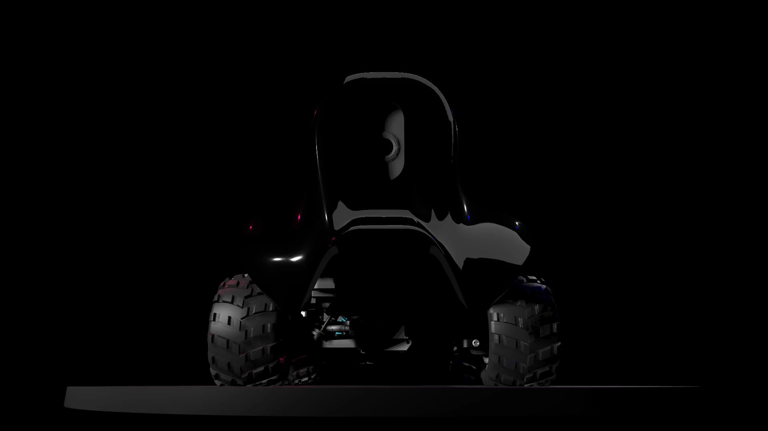


AWS DeepRacer car specifications
CAR 18th scale 4WD with monster truck chassis
CPU Intel Atom™ Processor
MEMORY 4GB RAM
STORAGE 32GB (expandable)
WI-FI 802.11ac
CAMERA 4 MP camera with MJPEG
DRIVE BATTERY 1000mAh lithium polymer
COMPUTE BATTERY 13600mAh USB-C
SENSORS Integrated accelerometer and gyroscope
PORTS 4x USB-A, 1x USB-C, 1x Micro-USB, 1x HDMI
SOFTWARE Ubuntu OS 16.04.3 LTS, Intel® OpenVINO™ toolkit, ROS Kinetic
Notes:
[2 minutes]
[Lift up a car and show them]
CAR 18th scale 4WD with monster truck chassis
CPU Intel Atom™ Processor
MEMORY 4GB RAM
STORAGE 32GB (expandable)
WI-FI 802.11ac
CAMERA 4 MP camera with MJPEG
SOFTWARE Ubuntu OS 16.04.3 LTS, Intel® OpenVINO™ toolkit, ROS Kinetic
DRIVE BATTERY 1100mAh lithium polymer
COMPUTE BATTERY 13600mAh USB-C PD
PORTS 4x USB-A, 1x USB-C, 1x Micro-USB, 1x HDMI
SENSORS Integrated accelerometer and gyroscope

Slide 27
AWS DeepRacer Software Architecture
ROS Nodes
ROS Msg Node
Stored File
Model Optimizer
Optimized Model
Model
Inference engine
Inference Results
Navigation Node
Autonomous Drive
Video M-JPEG
Control Node
Media engine
Web Server Video
Web Server Publisher
Manual Drive
Camera
Servo & Motor
Notes:
[2 minutes]
We use ROS v1.0 on top of Ubuntu to power the device.
Every time you load a model for autonomous driving in the car, it is optimized by Intel’s OpenVINO model optimizer
During autonomous driving, the pictures flow from the camera through the media engine, into the Intel OpenVINO inference engine, from where the inference results are converted into driving actions (this is the speed and direction), which flows into the control node that converts these to Pulse Width Modulation (PWN) signals that are sent to the engine and steering servo in the car.

Slide 28
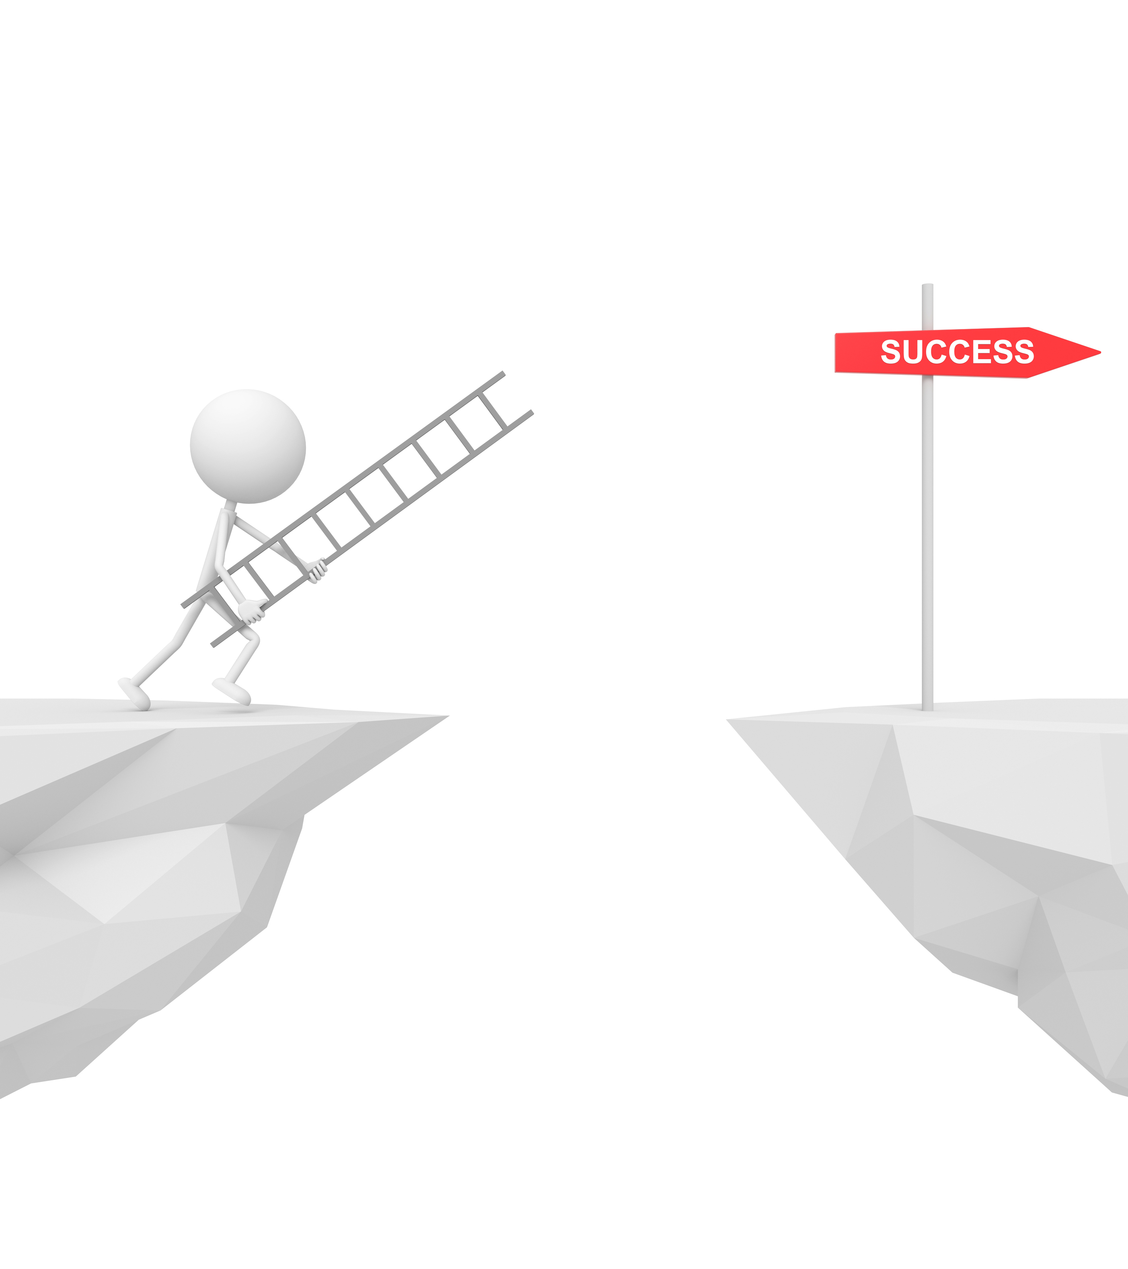
Simulation-to-Real Domain Transfer
SIM-to-REAL CHALLENGE
Train model using simulated images, but race car using real world images
STRATEGIES
Environment Control
Domain Randomization
Modularity and Abstraction
Notes:
[4 minutes]
A very important point to call out is the simulation to real domain transfer.
We trained our model in a simulated environment. It learned features from the simulated images. We will now attempt to use it in the real world with real world images. The real world doesn’t always look the same as the simulated world. This challenge is the sim-to-real domain transfer challenge.
How can we possibly bridge this gap… [pause]
1/ Control the environment. Make the simulator and real world seem as close to each other as possible. This is what you will see we have done. Our real-world tracks mimic the simulation environment
2/ Randomize the environment, this allows model to generalize. How can you do this? You change the textures/colors used in the simulation during the training process. This will make the model “insensitive” to the color of the line, and sensitive to a line. Another way would be to randomize physics, or camera field of view.
3/ Modularity and abstraction. Swap out parts of the model architecture, for example put a pre-trained model in place that can detect whether the upcoming road is straight, curves left, or curves right. Your model will then train on top of this additional info provided in the image.

Slide 29
Rubber Meets the Road
Notes:
[13 minutes remaining]
So that is a brief overview of RL, the console and reward functions.
Let’s wrap-up with a quick discussion of how you can get involved.

Slide 30
Race for prizes and glory in the AWS DeepRacer League
Train your AWS DeepRacer model and compete
Online in the Virtual Circuit
In person in the Summit Circuit
www.deepracerleague.com
Notes:
[2 min]
Finally, the AWS DeepRacer League will officially kick off later in 2019 with an online experience for everyone, and physical events at select locations co-hosted with AWS Summits. Stay tuned!
Developers train their models via the console for the fastest lap time, and can submit lap times to online leaderboards, or compete in-person at AWS Summits.
Winners of each stage progress to the DRL Cup at re:Invent 2019, to win the Champions Cup.

Slide 31
Name
Contact
Notes:
Thank you and Q&A [9 mins]

Slide 32
Reinforcement Learning terms
AGENT
ENVIRONMENT
STATE
ACTION
REWARD
EPISODE
VALUE FUNCTION
POLICY FUNCTION
Notes:
Agent
A piece of software, or model, that acts autonomously in a given environment to reach a specified goal
Environment
The environment with which our agent interacts
State
The current state of the environment that is visible, or known, to our agent and upon which it needs to act
Action
Given the current state our agent needs to take an action to try and achieve its goal. Action is taken based on exploring, or exploiting what the agent has learned
Reward
If the chosen action gets the agent closer to the goal, reinforce this action in future through a positive reward. Otherwise, discourage it with a negative reward, or no reward
Episode
Each iteration where an agents goes from the start position to a termination state (crashes off track or finishes track)
Value Function
The highest cumulative reward that can be achieved from any state by choosing the action and subsequent actions to maximize the reward for each action
Policy Function
A function that tells the agent how to act in each state. Our car knows which action to take at any position on the track

Slide 33
DeepRacer: Problem Formulation
AGENT
STATE
ACTION
ENVIRONMENT
GOAL
AGENT
MODEL
Notes:
[2 minute]
Before we dive into reward functions and how training takes place in AWS DeepRacer, let’s pause and take a look at the problem formulation.
We want AWS DeepRacer, our agent, to race around a track autonomously.
Our agent’s only view of the world is the input from its camera. We call this view the state
The agent needs a modelTo do this it needs a model.
Our agent moves in steps, that is around 15 times a second it will look at the state of the track and it will need to take an action.

Slide 34
RL algorithms – Policy Optimization
GOAL Directly map actions to states. CHALLENGE Need to visit all states, action, outcome combinations in the environment.
VERDICT Takes too long, let’s approximate!
HOW Use supervised learning to train a policy model that returns the best action for any state.
How do we know this is a good action? Because it gave the highest reward. Keep improving our model in the direction of the highest reward.
EXAMPLE: AWS DEEPRACER
Notes:
[2 minutes]
Policy function is a mapping from state directly to action.
Optimizing the policy function is a key method used in RL.
Parameterize a policy function, i.e. Create a neural network with weights. This network takes as input an image and spits out a range of probabilities over the possible actions. When we train our model we update the weights by trying to maximize the cumulative future reward, and in doing so we give higher probability to the action that leads to the higher cumulative future reward.
DeepRacer uses a form of Policy Optimization, called Proximal Policy Optimization.

Slide 35
RL algorithms – Proximal Policy Optimization
Actor (Policy)
Critic (Value)
(s_{t},a_{t}, r_{t}, s_{t+1})
advantage
Updating Policy using Clipped Loss
Preventing policy from being updated too much
Keeping the ratio of new and old policy in [0.8, 1.2]
Critic tells actor
how good the action taken was, and
how the actor should adjust its network
Notes:
[4 minutes]
Updating Policy using Clipped Loss
Preventing policy from being updated too much
Keeping the ratio of new and old policy in [0.8, 1.2]
Critic tells actor
how good the action taken was, and
how the actor should adjust its network

